Slide 1


Hangthim Limbu
17/10/2025

Slide 2

Outline
Executive Summary
Introduction
Methodology
Results
Conclusion
Appendix

Slide 3
Executive Summary
Different tools and libraries such as Pandas, numpy , scikit-learn, plotly and matplotlib were used to predict the success rate of SpaceX rocket launches with different features.
We realized that using Decision Tree with GridSearchCV is the best method to predict whether the launch will be success or

Slide 4
Introduction
The main goal of this project was to predict if falcon 9 first stage will land successfully or not .
The main objective here was to analyze and clean the data and find the right machine learning model to predict the landing using different metrics .

Slide 5

Section 1

Slide 6
Methodology
Executive Summary
Data collection methodology:
Data was collected using the spaceX API and the table from the Wikipedia page.
Perform data wrangling
Data was processed by using different python libraries such as Scaling and encodiung the data respectively.
Perform exploratory data analysis (EDA) using visualization and SQL
Perform interactive visual analytics using Folium and Plotly Dash
Perform predictive analysis using classification models
Data was split into training and testing set, then it was fed into the model, and the model was used to perform prediction and help calculate the accuracy of the predictions.

Slide 7
Data Collection (Using Static URL)
First of all, we used static url to collect the data in the json format.
Then we normalized the data and selected only columns that was needed such as , rocket, Launchpad, payloads, cores, flight_numbers etc.
Initially we have created a separated functions to get the data of booster version, launch site, payload data and core data.
we created a dictionary named launch_dict with all the necessary keys from the static_url and the functions
We converted the python dictionary into dataframe using pd.DataFrame method.

Slide 8
Data Collection (Using Web scraping)
Initialized some help functions such as date_time, booster_version, landing_status, get_mass, extract_column_from_header.
Initialized static URL and headers(so that website won’t block our request)
Used Beaufiful soup to extract the text from response and saved into the variable soup
Extracted the required table(i.e. third table) from the beautiful soup object
Extracted the required table heading and table row from the object and used nested for loop and above mentioned helper function to convert it into a dataframe.

Slide 9
Flowchart of Data Collection
static URL
Use static url to get the data in json format and save it in a variable
Normalize the json format such that it can be convered to dataframe
Pre-defined functions
Pre-defined functions were used such as , getBoosterVersion, getPayloadData, getLaunchSite etc
All the result were saved in a variable
Concat and converted into dataframe
All the above data were linked with the help of dictionaries with key-value pair
Dictionary was converted into pandas dataframe .

Slide 10
Data Collection – SpaceX API
GITHUB_URL=https://github.com/Hangthim-web/Collecting-Data-Handas-on-lab-coursera_-module-9-asisgnment/blob/main/jupyter-labs-spacex-data-collection-api.ipynb
Flowchart
static URL
Use static url to get the data in json format and save it in a variable
Normalize the json format such that it can be convered to dataframe
Pre-defined functions
Pre-defined functions were used such as , getBoosterVersion, getPayloadData, getLaunchSite etc
All the result were saved in a variable
Concat and converted into dataframe
All the above data were linked with the help of dictionaries with key-value pair
Dictionary was converted into pandas dataframe .

Slide 11
Data Collection - Scraping
GITHUB_URL=https://github.com/Hangthim-web/Collecting-Data-Handas-on-lab-coursera_-module-9-asisgnment/blob/main/jupyter-labs-webscraping.ipynb
Helper Functions
Initialized different helper functions to process web scraped HTML tables
Extract all column/variable names from the HTML table header
Create a data frame by parsing the launch HTML tables
Initialized variable for static_url and headers to be used in Beautiful Soup ojbect
Creating Dataframe
Beautiful Soup
Initialized Beautiful soup object using the response object.
soup = BeautifulSoup(response.text,'html.parser')
Place your flowchart of web scraping here

Slide 12
Data Wrangling
Data Wrangling phases:
Number of launches on each site were calculated .
Number and occurrences of each orbit were calculated.
Mission outcomes of each orbit were calculated
Set of outcomes were generated where the second stage did not land successfully.
Created a landing outcome label from outcome column

Slide 13
Flowchart of Data Wrangling Process
Number of launches on each site were calculated
Number and occurrences of each orbit were calculated
Created a landing outcome label from outcome column

Slide 14
Github URL for Data Wrangling
https://github.com/Hangthim-web/Collecting-Data-Handas-on-lab-coursera_-module-9-asisgnment/blob/main/labs-jupyter-spacex-Data%20wrangling.ipynb

Slide 15
EDA with Data Visualization
We used catplot with seaborn library with y as PayloadMass and x as FlightNumber with class hue. The objective of this plot was to learn about catplot and to visualize how the FlightNumber and Payload would affect the launch outcome.
Used scatterplot with x as FlightNumber and y as LaunchSite and hue as class. The objective of this chart was to visualize the relationship between FlightNumber and Launch Site.
Used scatterplot again with x as PayloadMass and y as LaunchSite with hue as class. The objective of this chart was to visualize the relation ship between Payload mass and launch Site

Slide 16
EDA with Data Visualization
We created scatterplot where PayloadMass was plotted in x-axis and orbit was plotted in y-axis, with class in the hue. The main objective of this chart was to visualize the relationship between Payload Mass and Orbit Type.
We created a line plot with date on x-axis and class on y-axis. The main objective of this chart was to visualize the relation between Date(year) and success rate.

Slide 17
EDA with Data Visualization
We created a barchart by grouping orbit column with mean from the class. Here, orbit was plotted in x-axis whereas class was plotted in y-axis. The main objective of this function was to visualize the relationship between success rate of each orbit type.
We used scatterplot with FlightNumber plotted in x-axis and Orbit plotted in y-axis and class in hue. The objective of this chart was to visualize the relationship between Flight Number and Orbit Type.

Slide 18
EDA with Data Visualization (GITHUB)
https://github.com/Hangthim-web/Collecting-Data-Handas-on-lab-coursera_-module-9-asisgnment/blob/main/jupyter-labs-eda-dataviz-v2.ipynb

Slide 19
EDA with SQL
%sql DROP THE TABLE IF EXISTS SPACEXTABLE. This commands drops the table SPACEXTABLE if it alreay exists in Database.
%sql SELECT DISTINCT LAUNCH_SITE FROM SPACEXTABLE. This command was used to display the names of unique launch sites in the space mission
%%sql SELECT LAUNCH_SITEFROM SPACEXTABLEWHERE LAUNCH_SITE LIKE 'CCA%'LIMIT 5; This command was used to display the 5 records where launch sites begin with the string ‘CCA’

Slide 20
EDA with SQL
%sql SELECT SUM(PAYLOAD_MASS__KG_) FROM SPACEXTABLE WHERE Customer LIKE "NASA%%“. This sql query is used to display the total payload mass carried by boosters launched by NASA(CRS)
%sql select avg(PAYLOAD_MASS__KG_) from SPACEXTABLE where Booster_Version = "F9 v1.1“. This query was used to display the average payload mass carried by booster version F9 v1.1
%sql select Date from SPACEXTABLE where Landing_Outcome='Success (ground pad)' order by Date limit 1. This query was used to list the date when the first successful landing outcome in ground pad was achieved .

Slide 21
EDA with SQL
%sql select Booster_Version from SPACEXTABLE where Landing_Outcome = 'Success (drone ship)' and PAYLOAD_MASS__KG_ between 4000 and 6000. This query was used to list the names of the boosters which have success in drone ship and have payload mass greater than 4000 but less than 6000.
%sql select Mission_Outcome,count(*) as total from SPACEXTABLE group by Mission_Outcome. This query is used to list the total number of successful and failure mission outcomes.
%%sql select DISTINCT Booster_Version from SPACEXTABLE where PAYLOAD_MASS__KG_ = (select max(PAYLOAD_MASS__KG_) from SPACEXTABLE). This query was used to list all the booster_version that have carried the maximum payload mass, using a subquery with a suitable aggregate function.

Slide 22
EDA with SQL
%%sqlSELECT substr(Date, 6, 2) AS month, Landing_Outcome, Booster_Version, Launch_SiteFROM SPACEXTABLEWHERE Landing_Outcome = 'Failure (drone ship)' AND substr(Date, 1, 4) = '2015'; This query is used to List the records which will display the month names, failure landing_outcomes in drone ship ,booster versions, launch_site for the months in year 2015
%%sqlselect Landing_Outcome,count(*) as Count from SPACEXTABLE where Date between '2010-06-04' and '2017-03-20' group by Landing_Outcome order by Count desc. This query is used to rank the count of landing outcomes (such as Failure (drone ship) or Success (ground pad)) between the date 2010-06-04 and 2017-03-20, in descending order.

Slide 23
EDA with SQL(GITHUB )
https://github.com/Hangthim-web/Collecting-Data-Handas-on-lab-coursera_-module-9-asisgnment/blob/main/jupyter-labs-eda-sql-coursera_sqllite.ipynb

Slide 24
Build an Interactive Map with Folium
I have used different folium object to create Interactive Map. They are discussed below along with its function.
Map() → This function is used to create and initialize a map .
Marker() → This function is used to mark a specific geographic point, a single latitude/longitude in the map .
Circle() → This method is used to make a circular region on the map around a center point.
add_child() → This method is used to attach one Folium object to another, usually adding map children elements to the parent

Slide 25
Build an Interactive Map with Folium
MarkerCluster() → This method is used to group a large number of nearby markers together into clusters. It is used to prevent clusters in the map.
Polyline() → This method is used to draw lines or paths on a map by connecting multiple geographic coordinates(latitude and longitude points)
GITHUB LINK → https://github.com/Hangthim-web/Collecting-Data-Handas-on-lab-coursera_-module-9-asisgnment/blob/main/lab_jupyter_launch_site_location.ipynb

Slide 26
Build a Dashboard with Plotly Dash
There was two major interaction in our dashboard.
Dropdown that selects the launch sites
Range Slider to adjust the payload (kg) range.
Dropdown selected sites including individual sites and All at once. It was used to visualize total launches by each sites
Range Slider was used to find the correlation between payload mass and Launch Success for all sites. We used scatterplot to plot the data with Booster Version Category
Github link -> https://github.com/Hangthim-web/Collecting-Data-Handas-on-lab-coursera_-module-9-asisgnment/blob/main/space-x-data.txt.txt

Slide 27
Predictive Analysis (Classification)
Used Standard Scaler to scale the data .
Split the data into training and testing dataset
Created a logistic regression model with cv=10 and used GridSearchCV object to find the best parameters from dictionary.
Used fit on GridSearchCV for training the model.
used predict function to get the prediction from the test dataset and also calculated the best_params_ and best_scores_ of the parameters .
Generated Confusion matrix for metrics respectivel.
Repeated step 3 to 6 with different machine learning algorithms.

Slide 28
Predictive Analysis (FlowChart)
Standard scaling the training dataset
Initialized the model
grid_obj.fit(X_train,y_train)
Initialized grid_obj=GridSearchCV()
Initialized the parameters
Calculated the best score and best parameters for grid_object for that particular model
Predicted the model using test dataset
Generated Confusion Matrix for the model evaluation
Split the data into training and testing dataset

Slide 29
Predictive Analysis (GITHUB)
https://github.com/Hangthim-web/Collecting-Data-Handas-on-lab-coursera_-module-9-asisgnment/blob/main/SpaceX_Machine%20Learning%20Prediction_Part_5.ipynb

Slide 30
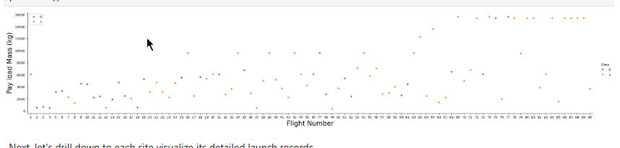
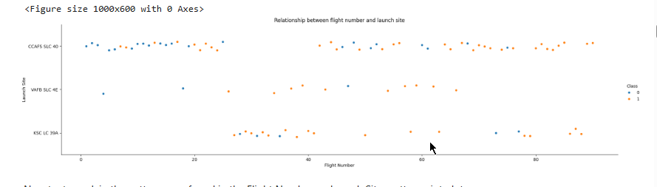
Results(EDA)

Slide 31
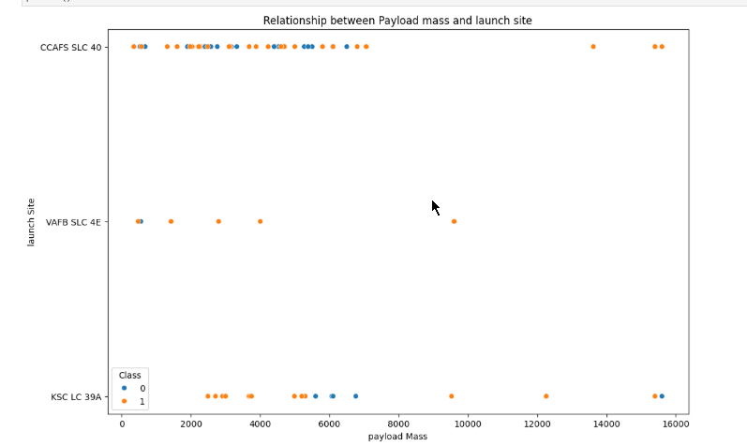
Results(EDA)

Slide 32
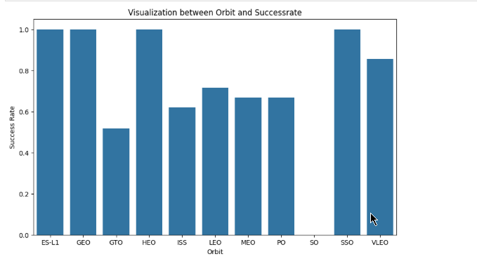
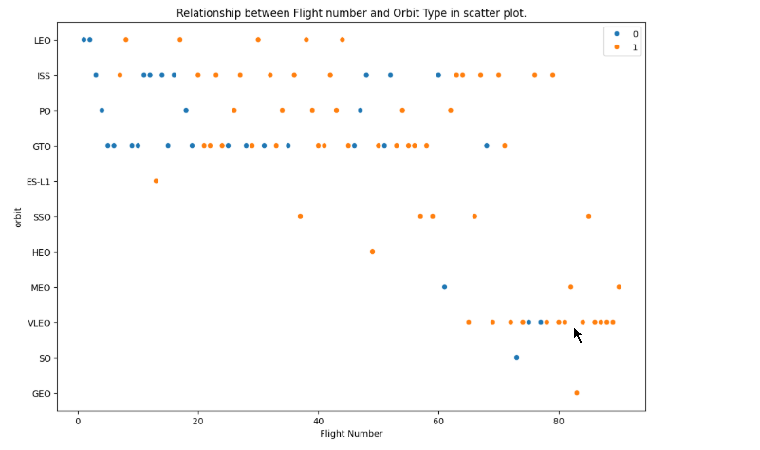
Results(EDA)

Slide 33
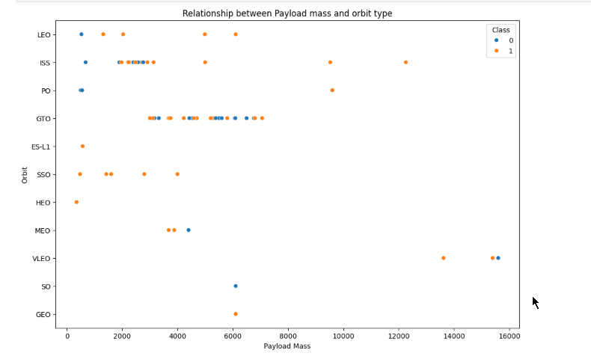
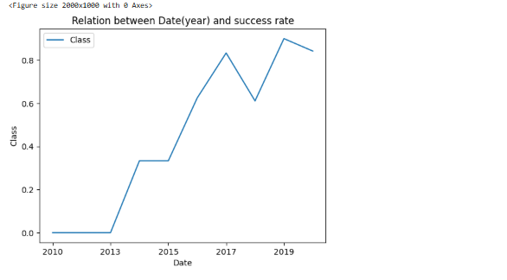
Results(EDA)

Slide 34
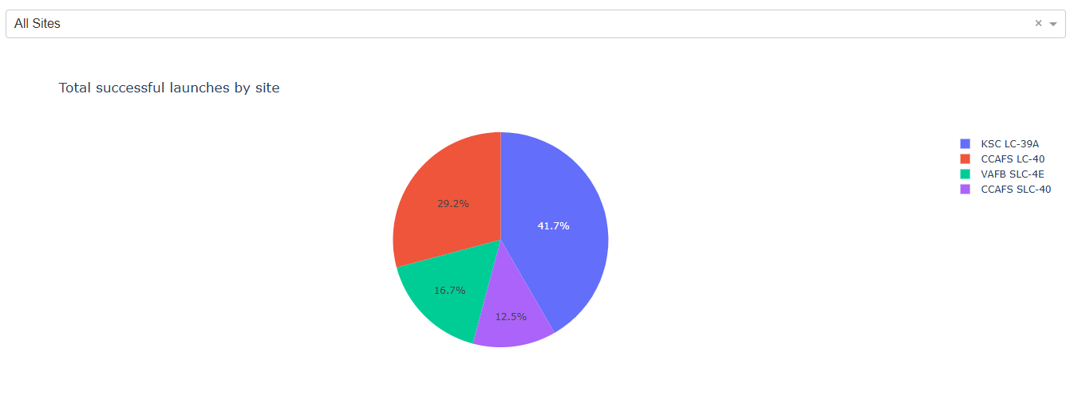
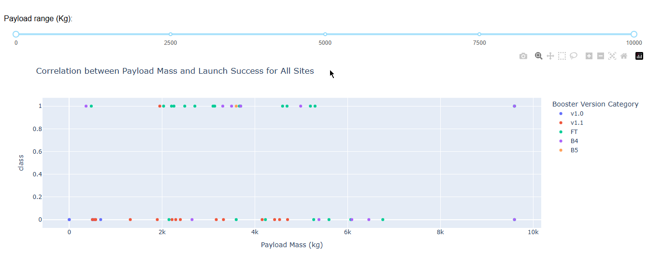
Results(Interactive Dashboard)

Slide 35
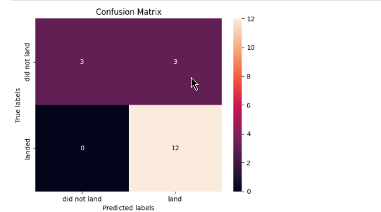
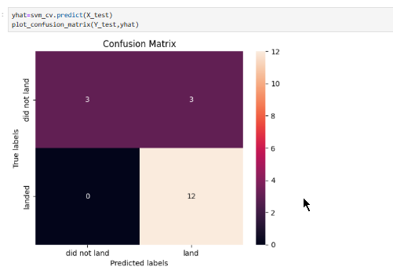
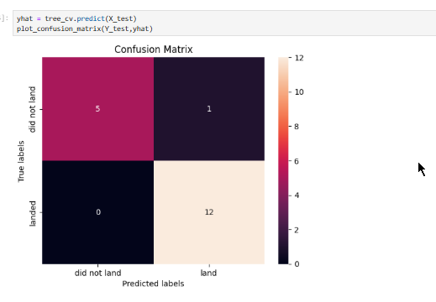
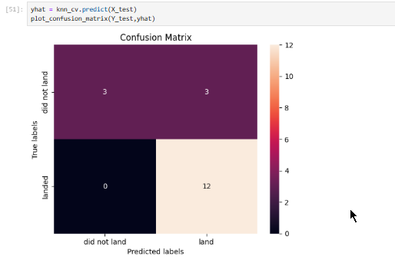
Results(Predictive Analysis)

Slide 36

Section 2

Slide 37
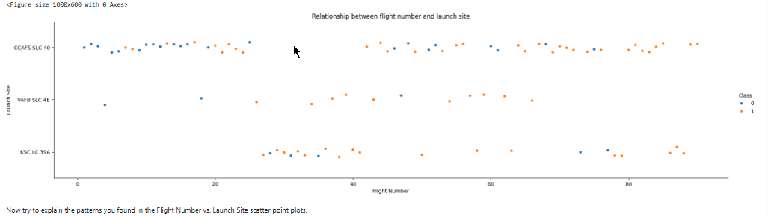
Flight Number vs. Launch Site
Scatter plot representing Flight Number vs Lanuch Site, where flight-number is in x-axis and launch site is at y-axis which is designated by class hue.

Slide 38
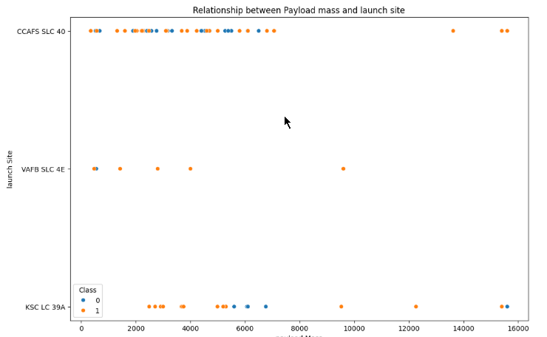
Payload vs. Launch Site
The above scatter plot shows the relation between payload mass and launch site. Payload mass is in x-axis whereas launch site is in the y-axis. The graph use class as use to differentiate the success or failure in landing.

Slide 39
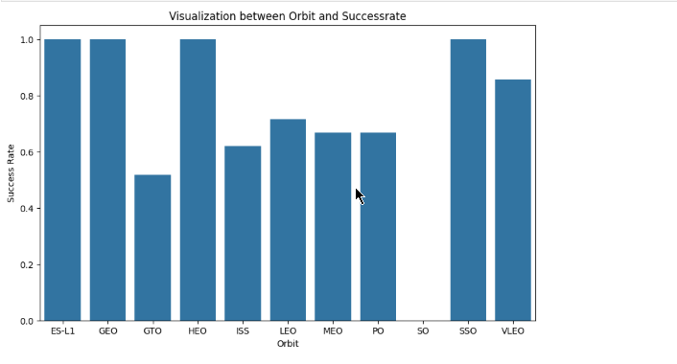
Success Rate vs. Orbit Type
The above bar chart shows the success rate of different orbits. Here, the orbits are mapped in the x-axis and success rate in the y-axis.

Slide 40
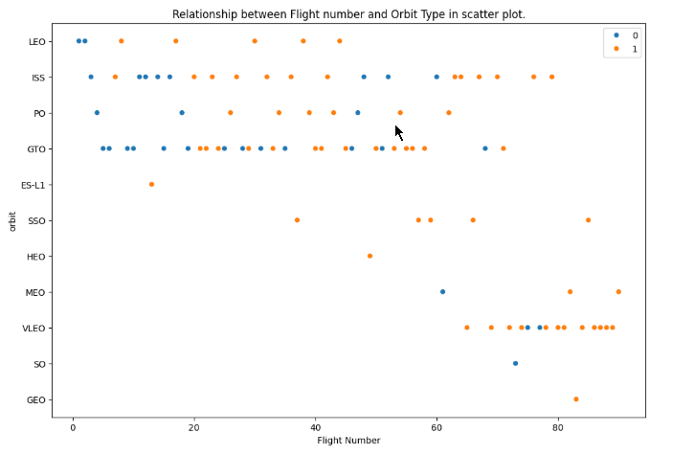
Flight Number vs. Orbit Type
Above scatterplot shows the relation between flight number and orbit types. Here, x-axis represents flight number and y-axis represents orbit.

Slide 41
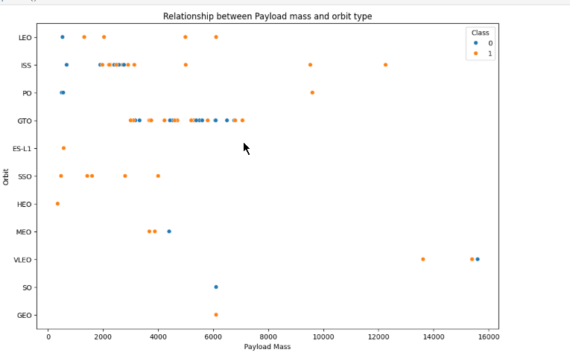
Payload vs. Orbit Type
The above scatterplot shows the relation between payload mass and orbit type. Payload mass takes x-axis position whereas orbit takes y-axis position.

Slide 42
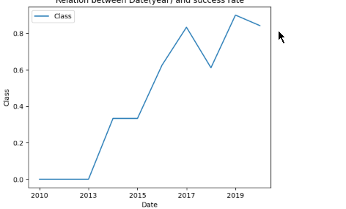
Launch Success Yearly Trend
The above line plot shows the relation success rate of different years , where 1 being the highest and 0 being the lowest.s

Slide 43
All Launch Site Names
%sql SELECT DISTINCT LAUNCH_SITE FROM SPACEXTABLE
CCAFS LC-40
VAFB SLC-4E
KSC LC-39A
CCAFS SLC-40

Slide 44
Launch Site Names Begin with 'CCA'
%%sql SELECT LAUNCH_SITEFROM SPACEXTABLEWHERE LAUNCH_SITE LIKE 'CCA%'LIMIT 5;
CCAFS LC-40
CCAFS LC-40
CCAFS LC-40
CCAFS LC-40
CCAFS LC-40

Slide 45
Total Payload Mass
%sql SELECT SUM(PAYLOAD_MASS__KG_) FROM SPACEXTABLE WHERE Customer LIKE "NASA%%“
Answer → 99980
Explaination → sum of payload from spacextable where customer starts with NASA

Slide 46
Average Payload Mass by F9 v1.1
%sql select avg(PAYLOAD_MASS__KG_) from SPACEXTABLE where Booster_Version = "F9 v1.1“
ANSWER → 2928.4
Explaination → Here, The average payload_mas_kg is calculated from spacextable where booster version is F9 v1.1

Slide 47
First Successful Ground Landing Date
%sql select Date from SPACEXTABLE where Landing_Outcome='Success (ground pad)' order by Date limit 1
Answer → 2015-12-22
Explaination -> Selecting date from spacextable using order by to sort the date and limit of 1 to just extract the first data.

Slide 48
Successful Drone Ship Landing with Payload between 4000 and 6000
%sql select Booster_Version from SPACEXTABLE where Landing_Outcome = 'Success (drone ship)' and PAYLOAD_MASS__KG_ between 4000 and 6000
F9 FT B1022
F9 FT B1026
F9 FT B1021.2
F9 FT B1031.2
Explaination → used select statement with where condition to extract the Booster version of payload mass between 4000 and 6000.

Slide 49
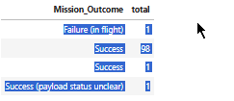
Total Number of Successful and Failure Mission Outcomes
%sql select Mission_Outcome,count(*) as total from SPACEXTABLE group by Mission_Outcome.
Explaination : Used select statement and count statement with the help of group statement to find the Total failure and success rate of mission outcome.

Slide 50
Boosters Carried Maximum Payload
%%sql select DISTINCT Booster_Version from SPACEXTABLE where PAYLOAD_MASS__KG_ = (select max(PAYLOAD_MASS__KG_) from SPACEXTABLE)
F9 B5 B1048.4
F9 B5 B1049.4
F9 B5 B1051.3
Explaination → Selected Unique Booster_Version by using Distinct query and a sub query.

Slide 51
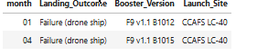
2015 Launch Records
%%sqlSELECT substr(Date, 6, 2) AS month, Landing_Outcome, Booster_Version, Launch_SiteFROM SPACEXTABLEWHERE Landing_Outcome = 'Failure (drone ship)' AND substr(Date, 1, 4) = '2015';

Slide 52
Rank Landing Outcomes Between 2010-06-04 and 2017-03-20
%%sqlselect Landing_Outcome,count(*) as Count from SPACEXTABLE where Date between '2010-06-04' and '2017-03-20' group by Landing_Outcome order by Count desc
No Attempt ➔ 10
Success (drone ship) ➔ 5
Failure (drone ship) ➔ 5
Success (ground pad) ➔ 3
Controller (Ocean) ➔3
Uncontrolled (Ocean) ➔ 2
Failure (Parachute) ➔ 2
Precluded (drone ship) ➔ 1

Slide 53

Section 3

Slide 54
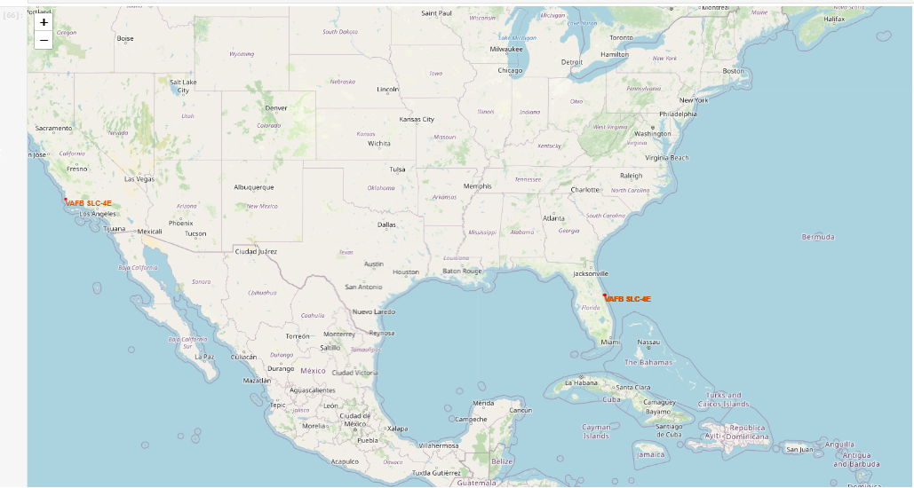
Mapping Launch Site with Folium
This map shows different launch sites located in USA.

Slide 55
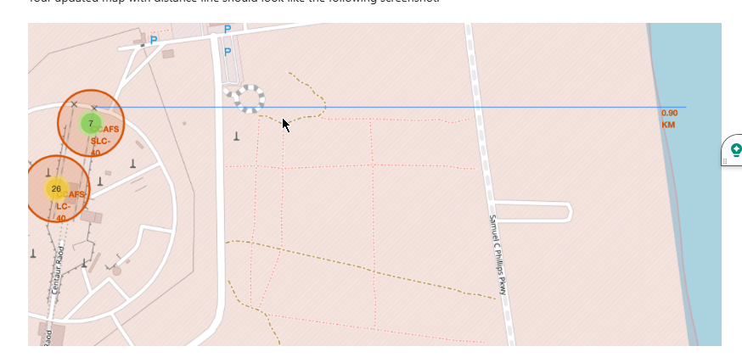
Calculated the distance With Shore
Calculated the distance between the nearest seashore and the launch site.

Slide 56
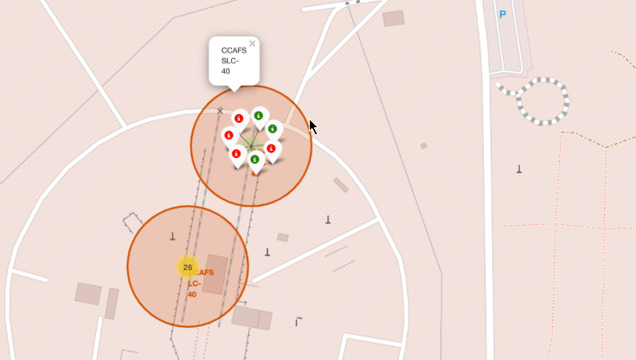
Success and Failure Class for each launch site

Slide 57

Section 4

Slide 58
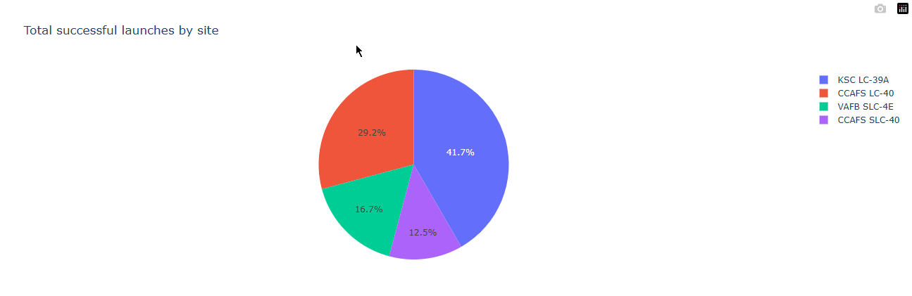
Total successful launces by all site
KSC LC-39A seems to have the highest success rate whereas CCAFS SLC-40 has the lowest success rate as seen from the pie chart.

Slide 59
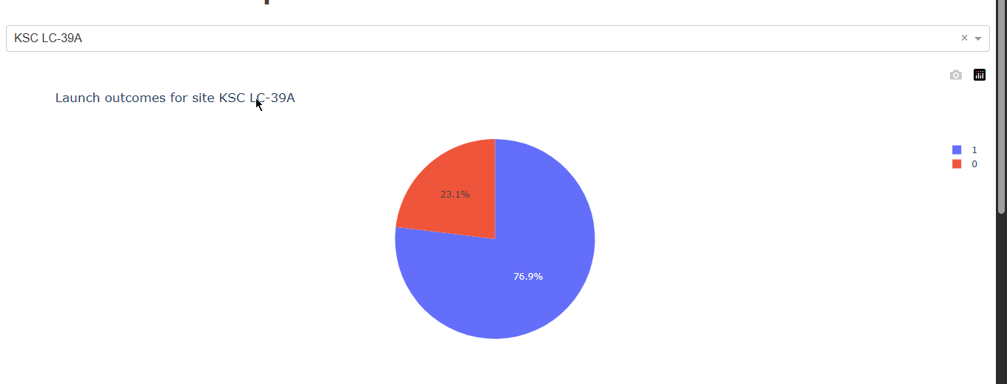
Piechart for the launch site with highest launch success ratio.
The above piechart shows the launch outcomes for site KSC LC-39A with success rate of 76.9%.

Slide 60
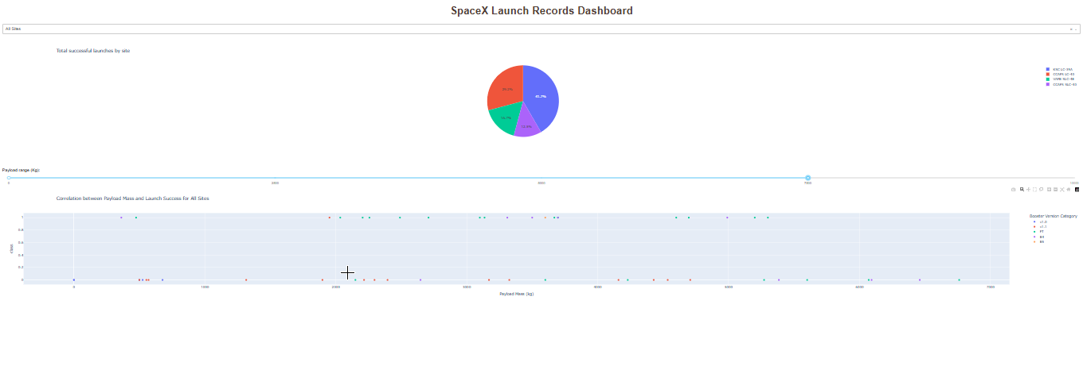
Payload vs Launch Outcome scatter plot for all sites, with different payload selected in the range slider.
The range of payload mass between 0 and 7500 gives the highest success rate

Slide 61

Section 5

Slide 62
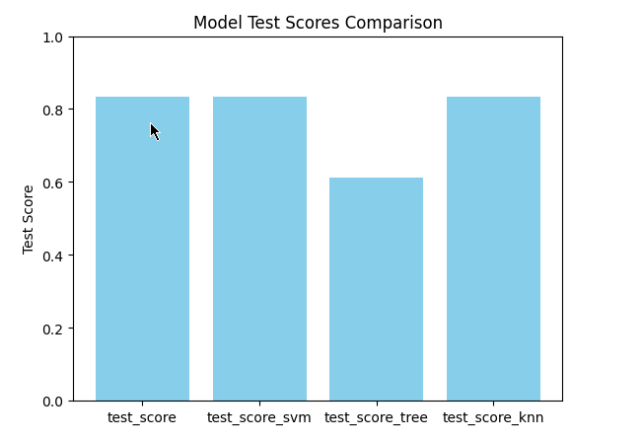
Classification Accuracy
From this graph it seems that Logistic Regression, SvM and KNN all three have the highest score of around 8.33 where as decision tree has the lowest score of 61

Slide 63
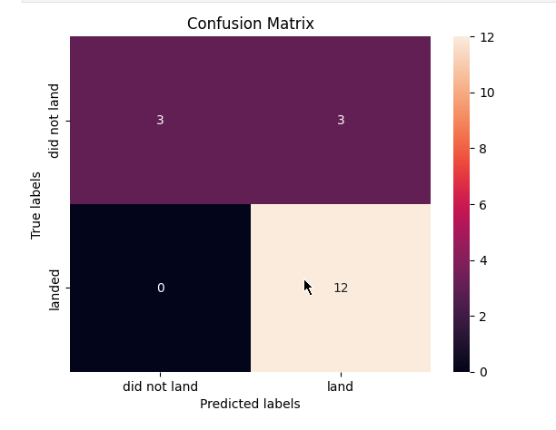
Confusion Matrix
This is the confusion matrix of KNN and it can be seen that there is There are 3 samples in True Positive and 12 samples in True Negative but 3 samples is False Negative, meaning that 3 samples were positive but flasly classified as negative.

Slide 64
Conclusions
Point 1
Point 2
Point 3
Point 4
…

Slide 65
Appendix
Include any relevant assets like Python code snippets, SQL queries, charts, Notebook outputs, or data sets that you may have created during this project

Slide 66


